Slide 1
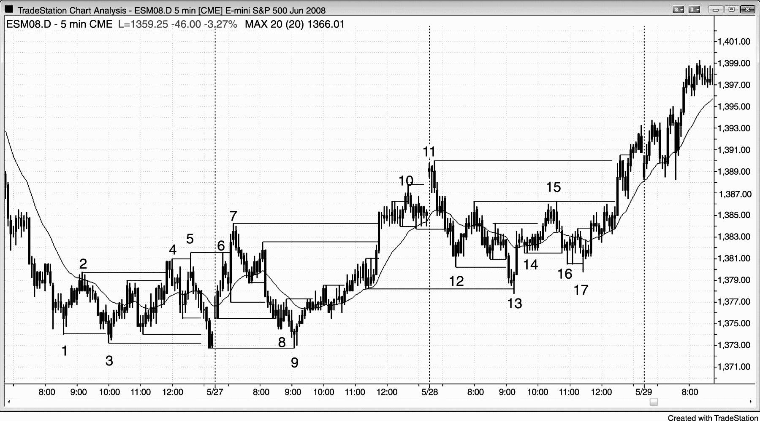
FIGURE 17.1 Breakouts Can Set Up Reversals

Slide 2
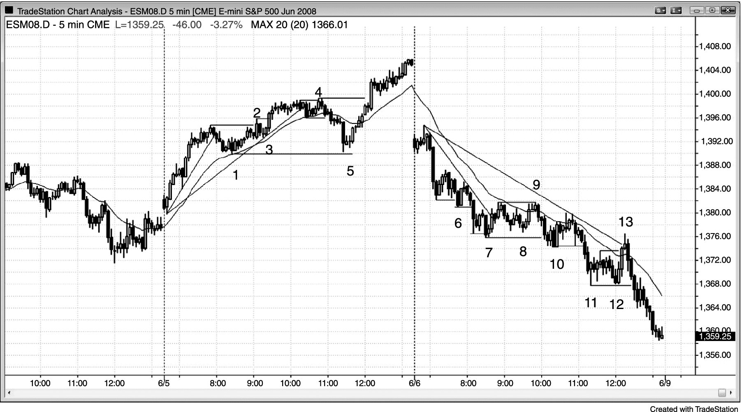
FIGURE 17.2 Don’t Fade Strong Trends

